Slide 1



News App
Team:
1.Ravula Yaswanth
2.Bhavanam Kishore kumar Reddy
3.Karedla SimhaManorajan Reddy
4.Dedeepya Lakshmi Devaki

Slide 2
Outline
Problem Statement
Objective
Microservices
Project Overview
Onboarding-Architecture
Project Flow
Technology and Tools Used
Conclusion

Slide 3

Problem Statement
X wants to check the news from around him/her. X is able to register themselves in the application, get the news updates and add news to favorites .

Slide 4
Objective
Our objective is to provide best user experience to X .
X can be able to Register, login & logout.
X can know news updates.
X can add/delete News to/from favorites in X’s account.

Slide 5
Microservices
Authentication API
Favorite API
External API Service

Slide 6
Project Overview

Slide 7
Project Overview
Authentication API
Favorite API
External API Service
Login
Authentication API
Favorite API
External API Service
Top
News List
Home
Favourites List
Search
Register
External API
SQL
Server
SQL
Server
Internet

Slide 8
Onboarding Architecture

Slide 9
Architecture
Authentication API
JWT validator
SQL Server
Login/Register
POST request
Token generated
Top News API
Get Top News
GET
NewsApi.org
Front End
Angular
Favorite News
Get Favorite News
Post Favorite News
Delete Favorite News
POST /GET/
DELETE
SQL Server
POST /GET/
DELETE
GET
Search News
GET
NewsApi.org

Slide 10
Class Diagrams
-

Slide 11
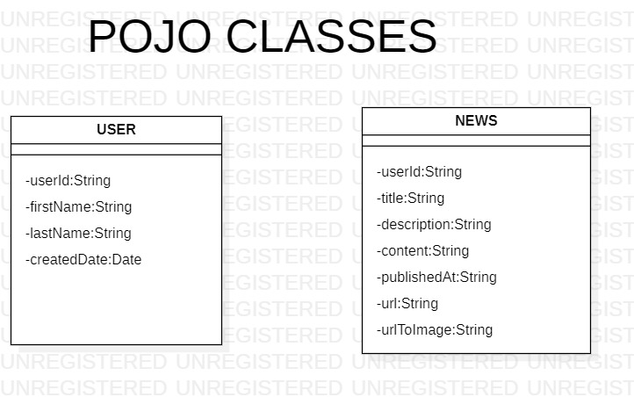

Slide 12
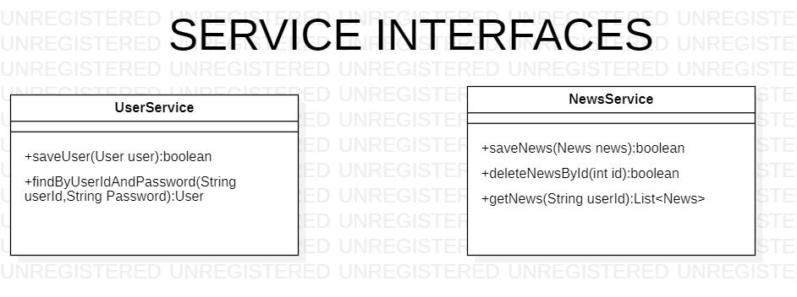

Slide 13
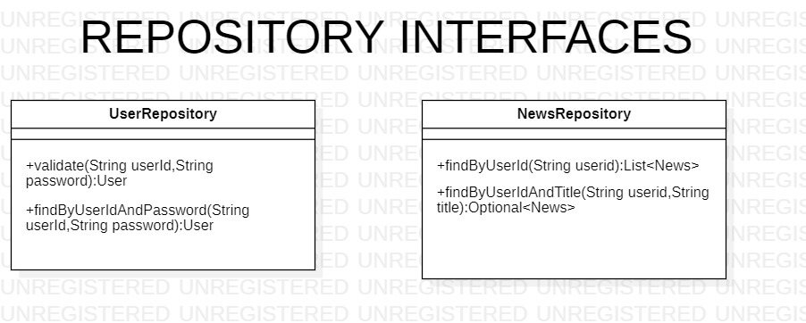

Slide 14
Project Flow

Slide 15
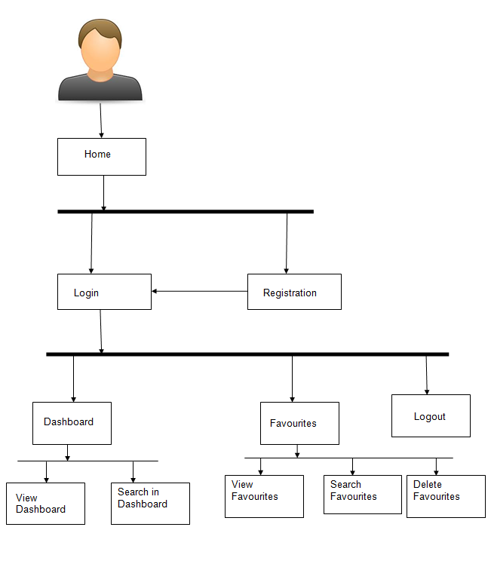
Project Flow
Home
Login
Register
Top News
Favorites
Search News
Recommends
Add to Favorites
View favorites
Delete favorites
Search Books

Slide 16






Technologies and Tools Used

Slide 17
Conclusion
News app helps the users to know the various news updates.It also helps user to add/remove certain news into favorites list.

Slide 18
Thank You

Slide 19


